Slide 1


DEPARTMENT OF INFORMATION TECHNOLOGY
IT-8811 MAJOR PROJECT
“KYAAT”
Kinesics Recognition

Slide 2
PROJECT TITLE
KYAAT
Specialization : Human Computer Interaction
Name of the Supervisor : Dr. D. Weslin, M.E., Ph.D.
Team Members:
Boobalan V 311820205008
Imaam Jaffar J 311820205010
Mohamed Ghazali P 311820205019
Notes:
2

Slide 3
ABSTRACT
Our project, 'KYAAT', wants to change how people use computers by letting them control the mouse without touching it. We'll use special technology like cameras and hand recognition to understand how your hands move.
Then, we'll make the computer move the mouse based on what your hands are doing. This will make it easier for people who can't move around easily to use computers.
It'll feel more natural and fun, like you're just waving your hands to make things happen on the screen.
We're working on making sure the system works well and is easy for everyone to use. Overall, we hope this project will make using computers more enjoyable and accessible for everyone.

Slide 4
LITERATURE REVIEW
TITLE: Advancements in Virtual Mouse Technology for Enhanced Accessibility
Author: R. Gupta et al.
Year: 2019
Explanation: This study explores advancements in virtual mouse technology, focusing on improving accessibility for users with disabilities. It discusses features such as gesture recognition and customization, highlighting their potential in enhancing user experience and inclusivity in HCI.

Slide 5
LITERATURE REVIEW
Title: Comparative Analysis of Virtual Mouse Versatility in Human-Computer Interaction
Author: S. Patel et al.
Year: 2018
Explanation: Patel et al.'s study compares the versatility of virtual mouse with traditional physical mice in the context of HCI. It emphasizes the advanced features of virtual mice, such as gesture recognition, and how these contribute to enhanced user productivity and satisfaction.

Slide 6
INTRODUCTION
The word KYAAT is derived from mother tongue Tamil language which means “kai” and “Aatu” (moving our hands).
Human-computer interaction has become an integral part of our daily lives. One essential component of this interaction is the input device used to control and navigate the graphical user interfaces (GUIs) of computers and devices.
While traditional physical mouse have long been the standard input device, technological advancements have given rise to virtual mouse, offering new possibilities and convenience in how we interact with technology.
Notes:
6

Slide 7
INTRODUCTION
Our project is called KYAAT Kinesics Mouse Control Using Gestures. We're working on a way for you to control the computer just by moving your hands.
If you wave your hand, and the computer does what you want. This makes it easier for everyone to use computers, even if they have trouble with regular mouse and keyboard.
Notes:
7

Slide 8
OBJECTIVE
The goal of the 'KYAAT' project is to make a system that lets you interact with computers using your hands. We want to instruct the computer to recognize how your hand moves by using camera.
This project helps you to use the computer without using any physical devices, which can be helpful in many situation. We also want to make sure the system is easy to use and works well for everyone.

Slide 9
EXISTING SYSTEM
Most of the computers needs mouse and trackpads for you to access the computer. But these can be hard to use, especially if you can't move around easily.
The mouse is a key computer input device used to control the graphical user interface (GUI) through two-dimensional movements on a surface.
Initially, mechanical mouse with rubber balls were used, later replaced by optical mouse using LED sensors, and then laser mouse for more accuracy.

Slide 10
PROPOSED SYSTEM
The KYAAT (Virtual Mouse system) proposed in this work leverages the most efficient and expressive forms of human communication is Hand gestures.
This modes of communication is universally understood, even by individuals.
The system's experimental setup involves a cost-effective webcam positioned at top of a computer monitor or a fixed laptop camera, inputs that are processed to execute various mouse functions.

Slide 11
SPECIFICATIONS
HARDWARE SPECIFICATIONS:
Device : Webcam
CPU : intel i3 or high
RAM: 4GB or Above
Memory: 8GB or Above

Slide 12


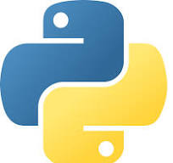

SPECIFICATIONS
SOFTWARE SPECIFICATIONS: Operating System : Windows 7 or above
IDE : Visual studio
Language : Python
Environment : Anaconda

Slide 13
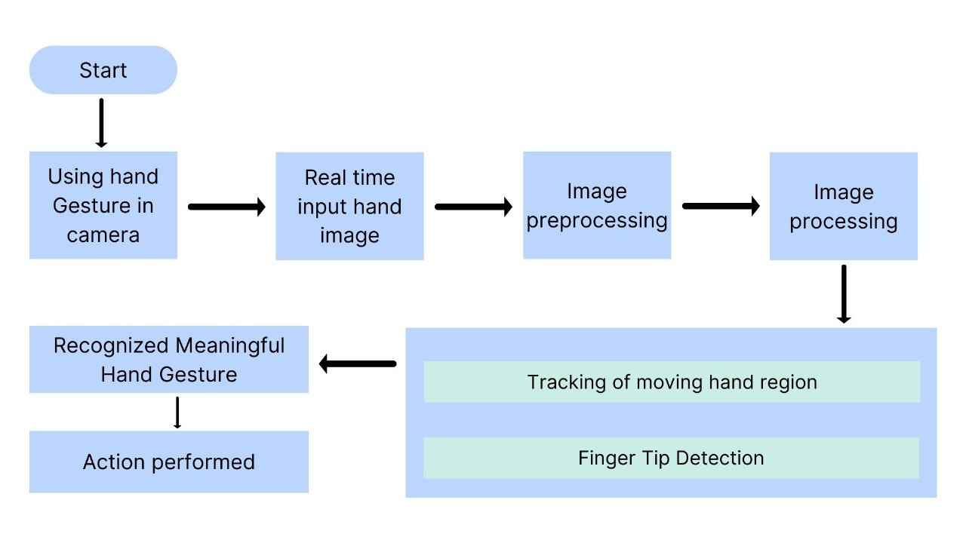
ARCHITECTURE

Slide 14
MODULES USED
`import cv2`: OpenCV library for computer vision tasks such as image and video processing.
`import mediapipe as mp`: Mediapipe library for real-time solutions in areas like hand tracking and pose estimation.
`import pyautogui`: PyAutoGUI library for programmatically controlling the mouse and keyboard.
`import math`: Standard Python library for mathematical functions and operations.
`from enum import IntEnum`: Enum module for creating enumerations with integer values.

Slide 15
MODULES USED
`from ctypes import cast, POINTER`: CTypes library for low-level manipulations and interfacing with C code.
`from comtypes import CLSCTX_ALL`: COMTypes library for COM (Component Object Model) interfacing in Windows.
`from pycaw.pycaw import AudioUtilities, IAudioEndpointVolume`: PyCAW library for controlling audio devices and volumes in Windows.
`from google.protobuf.json_format import MessageToDict`: Protobuf library for converting Protobuf messages to Python dictionaries.
`import screen_brightness_control as sbcontrol`: Screen Brightness Control library for adjusting screen brightness programmatically.

Slide 16
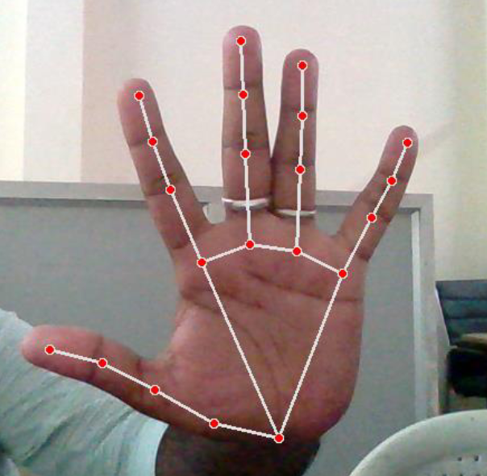
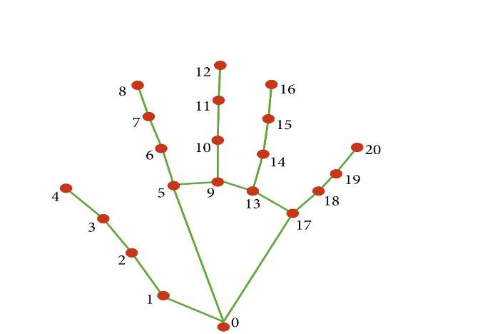
HAND TRACKING

Slide 17
HAND TRACKING
0. WRIST 1. THUMB_CMC 2. THUMB_MCP 3. THUMB_IP 4. THUMB_TIP 5. INDEX_FINGER_MCP 6. INDEX_FINGER_PIP 7. INDEX_FINGER_DIP 8. INDEX_FINGER_TIP 9. MIDDLE_FINGER_MCP 10. MIDDLE_FINGER_PIP | 11. MIDDLE FINGER DIP 12. MIDDLE_FINGER_TIP 13. RING_FINGER_MCP 14. RING_FINGER_PIP 15. RING_FINGER_DIP 16. RING_FINGER_TIP 17. PINKY_MCP 18. PINKY_PIP 19. PINKY_DIP 20. PINKY_TIP

Slide 18
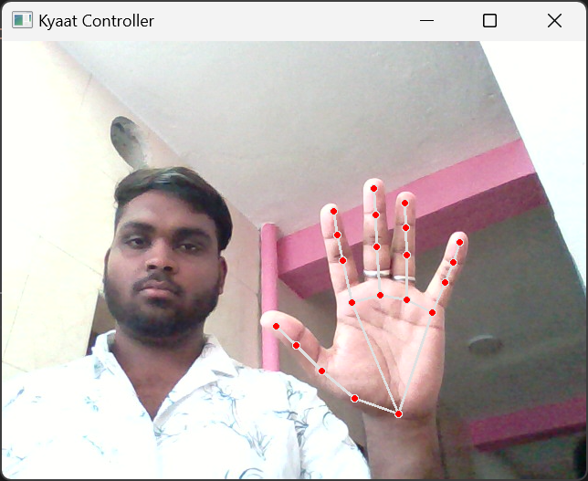
SAMPLE OUTPUT (NEUTRAL GESTURE)

Slide 19
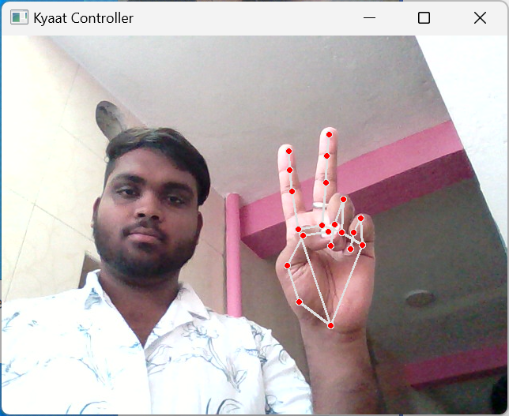
SAMPLE OUTPUT (MOVE CURSOR)

Slide 20
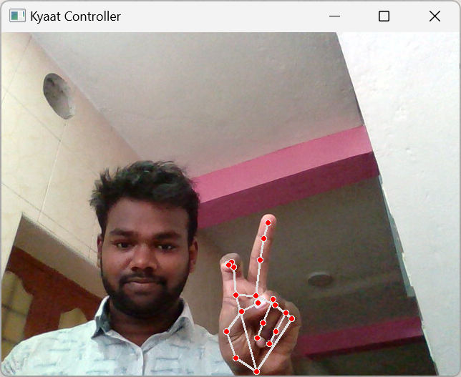
SAMPLE OUTPUT (LEFT CLICK)

Slide 21
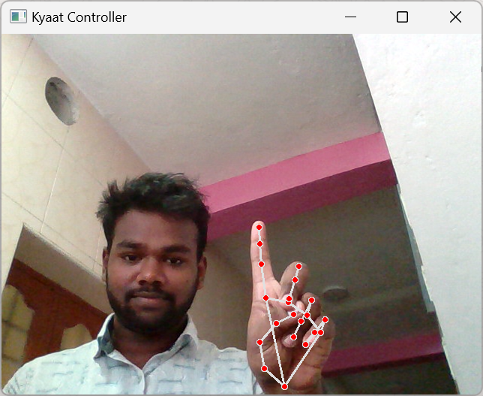
SAMPLE OUTPUT (RIGHT CLICK)

Slide 22
ADVANTAGES
Flexibility: Users are not constrained by physical input devices like mouse or touchpads, allowing for more freedom of movement and interaction.
Space Efficiency: In environments where desk space is limited, a gesture-based control system can be more practical than traditional input devices.
Adaptability: The system can be adapted to different user preferences and needs, allowing for personalized interaction experiences.

Slide 23
FUTURE IMPROVEMENTS
There are several features and improvements needed in order for the program:
Smart Movement: Due to the current recognition process within limited radius, an adaptive zoom in/out functions are required to improve the covered distance, where it can automatically adjust the focus rate based on the distance between the users and the webcam.
Better Accuracy & Performance: The response time are heavily relying on the hardware of the machine, this includes the processing speed of the processor, the size of the available RAM, and the available features of webcam.

Slide 24
CONCLUSION
The basic goal of the virtual mouse system is to control the mouse cursor and complete activities without needing a physical mouse by using hand gestures.
This proposed system is created by using a webcam (or any built-in camera) that recognises hand gestures and hand tip movement and processes these frames to perform the relevant mouse actions.
The proposed model has been tested for high sophistication, the virtual mouse can be used for real-time applications.

Slide 25
REFERENCES
Gupta, R., et al. (2019). "Advancements in Virtual Mouse Technology for Enhanced Accessibility." Proceedings of the International Conference on Human-Computer Interaction, 145-158.
Patel, S., et al. (2018). "Comparative Analysis of Virtual Mouse Versatility in Human-Computer Interaction." Journal of Interaction Design and User Experience, 10(3), 212-225.

Slide 26
Thank You
☺

